Slide 1
Graphics

Slide 2
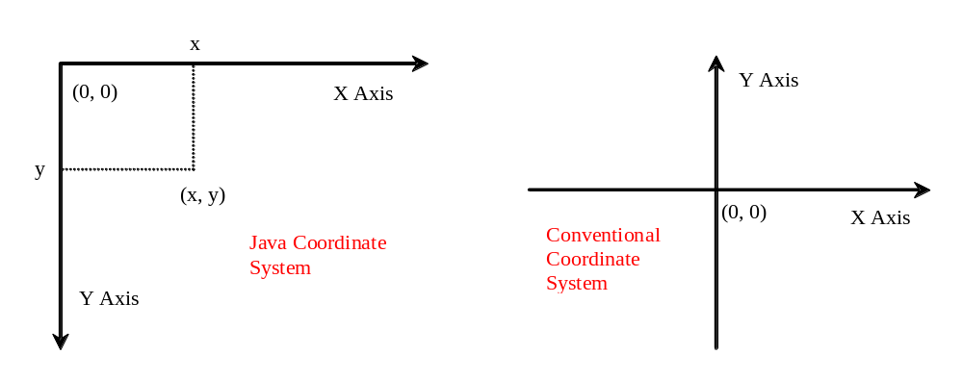
Java Coordinate System

Slide 3
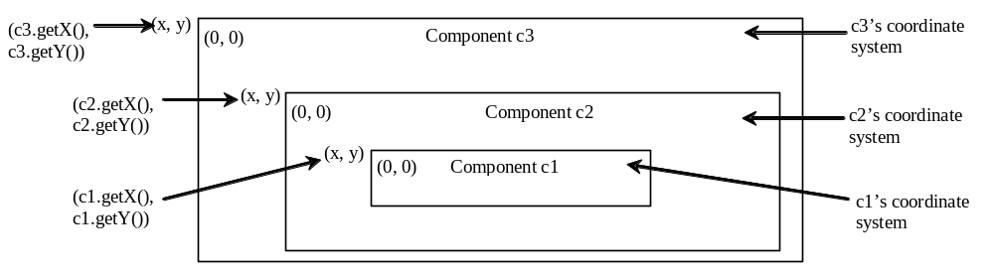
Each GUI Component Has its Own Coordinate System

Slide 4
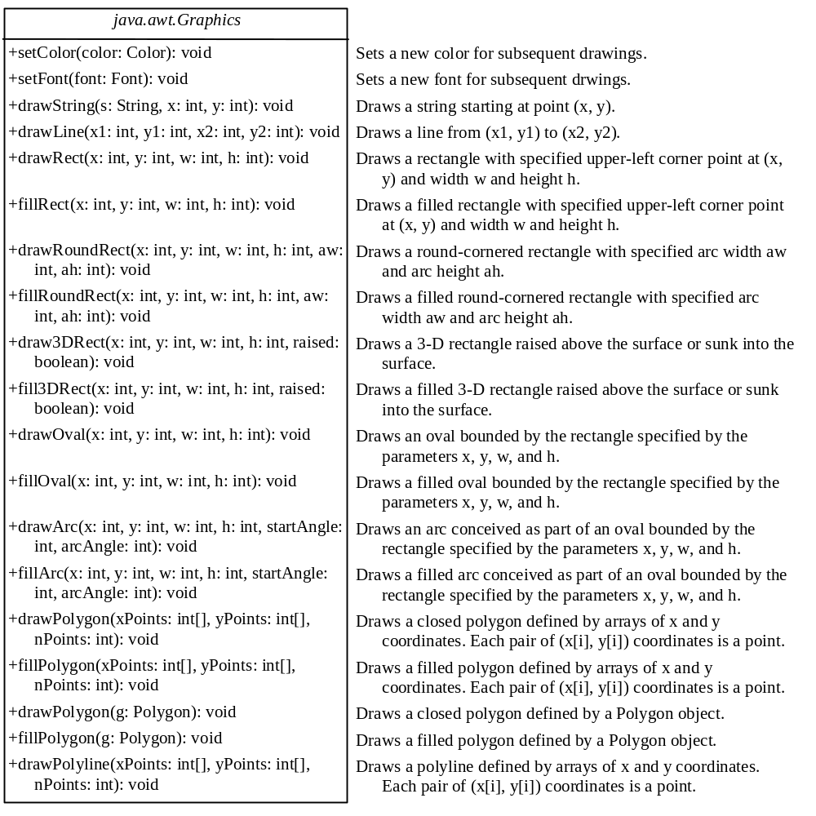
The Graphics Class
You can draw strings, lines, rectangles, ovals, arcs, polygons, and polylines, using the methods in the Graphics class.

Slide 5
Obtaining Graphics Object
The Graphics class is an abstract class that provides a device-independent graphics interface for displaying figures and images on the screen on different platforms. Whenever a component (e.g., a button, a label, a panel) is displayed, a Graphics object is created for the component on the native platform. This object can be obtained using the getGraphics() method. For example, the graphics context for a label object jlblBanner can be obtained using
  Graphics graphics = jlblBanner.getGraphics();
You can then apply the methods in the Graphics class to draw things on the label’s graphics context.

Slide 6
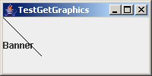
A Drawing Example
(0, 0)
(50, 50)
Draw a line and a text
TestGetGraphics

Slide 7
The paintComponent Method
The paintComponent method is defined in JComponent, and its header is as follows:
  protected void paintComponent(Graphics g)
This method, defined in the JComponent class, is invoked whenever the component is first displayed or redisplayed.

Slide 8
Drawing Geometric Figures
Drawing Strings
Drawing Lines
Drawing Rectangles
Drawing Ovals
Drawing Arcs
Drawing Polygons

Slide 9
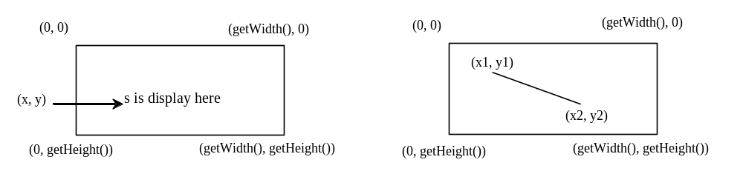
Drawing Strings
drawString(String s, int x, int y);
drawLine(int x1, int y1, int x2, int y2);

Slide 10
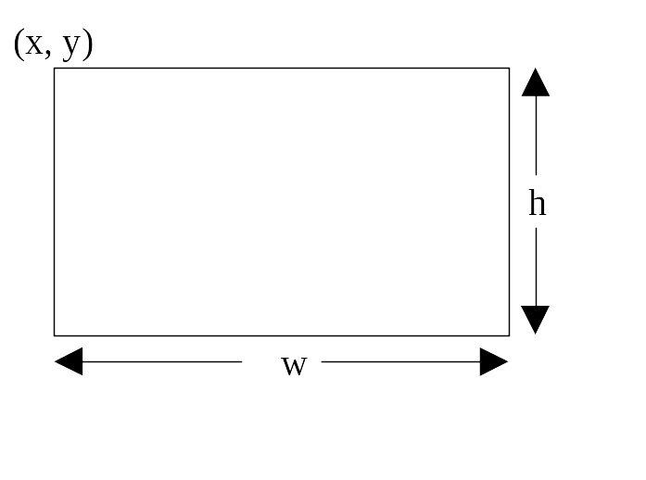
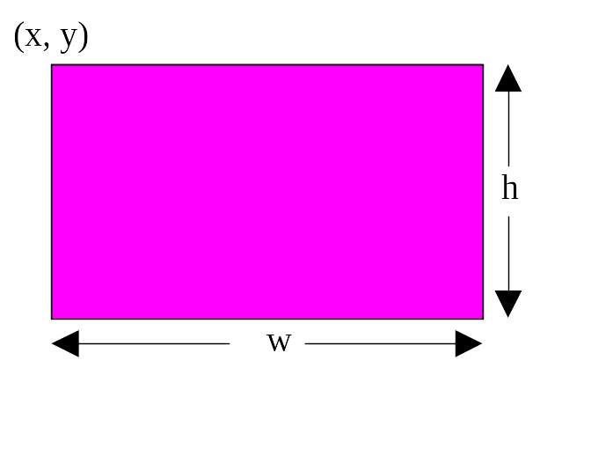
Drawing Rectangles
drawRect(int x, int y, int w, int h);
fillRect(int x, int y, int w, int h);

Slide 11
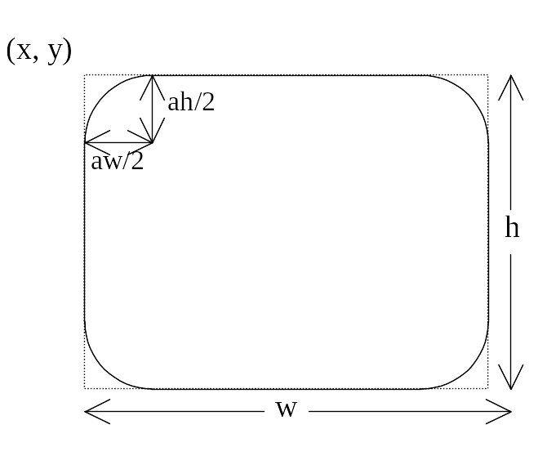
Drawing Rounded Rectangles
drawRoundRect(int x, int y, int w, int h, int aw, int ah);
fillRoundRect(int x, int y, int w, int h, int aw, int ah);

Slide 12
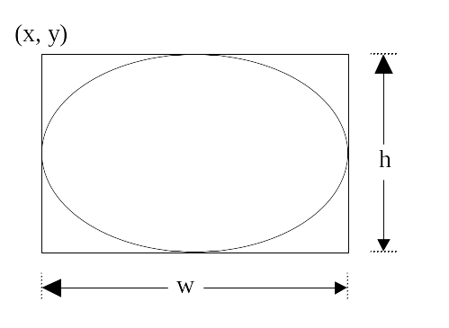
Drawing Ovals
drawOval(int x, int y, int w, int h);
fillOval(int x, int y, int w, int h);

Slide 13
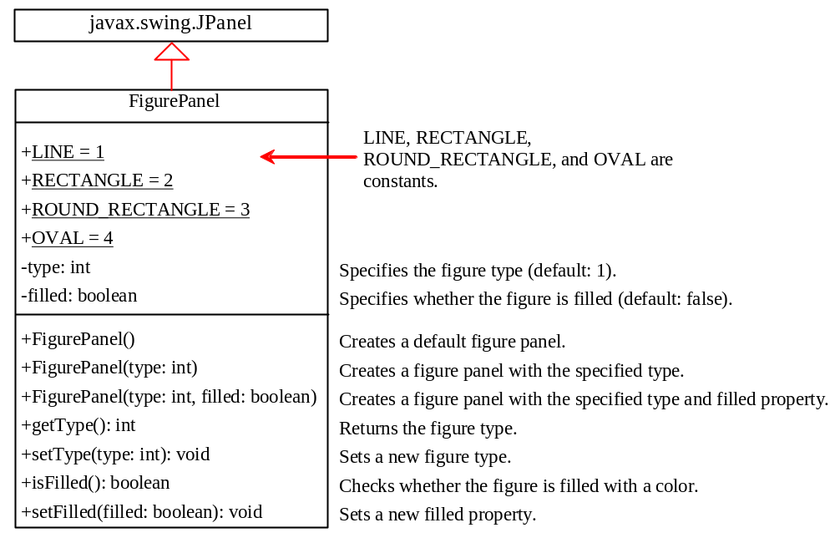
Case Study: The FigurePanel Class
This example develops a useful class for displaying various figures. The class enables the user to set the figure type and specify whether the figure is filled, and displays the figure on a panel.
FigurePanel

Slide 14
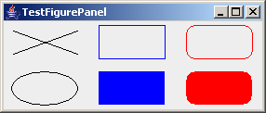
Test FigurePanel
This example develops a useful class for displaying various figures. The class enables the user to set the figure type and specify whether the figure is filled, and displays the figure on a panel.
TestFigurePanel

Slide 15
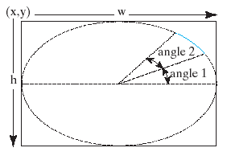
Drawing Arcs
drawArc(int x, int y, int w, int h, int angle1, int angle2);
fillArc(int x, int y, int w, int h, int angle1, int angle2);
Angles are in degree

Slide 16
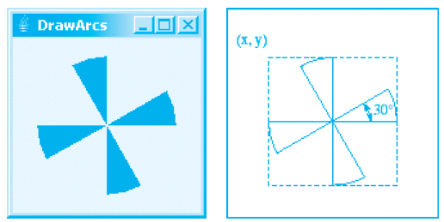
Drawing Arcs Example
DrawArcs

Slide 17
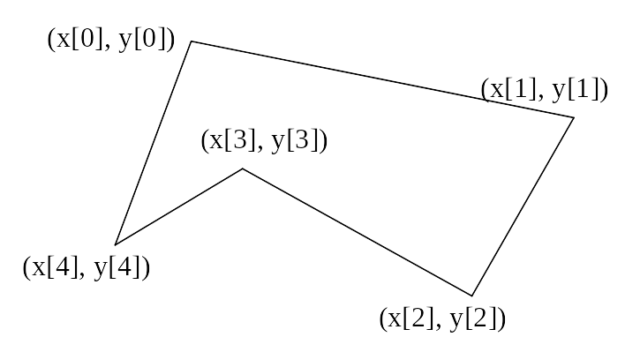
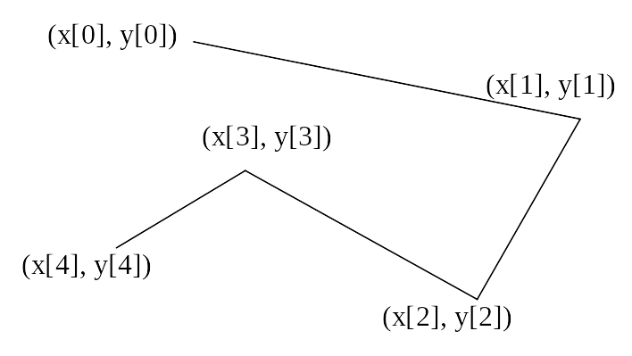
Drawing Polygons and Polylines
int[] x = {40, 70, 60, 45, 20};
int[] y = {20, 40, 80, 45, 60};
g.drawPolygon(x, y, x.length);
g.drawPolyline(x, y, x.length);

Slide 18
Drawing Polygons Using the Polygon Class
Polygon polygon = new Polygon();
polygon.addPoint(40, 59);
polygon.addPoint(40, 100);
polygon.addPoint(10, 100);
g.drawPolygon(polygon);

Slide 19
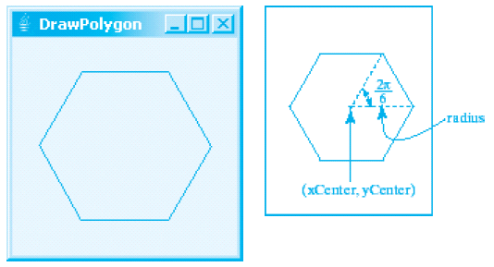
Drawing Polygons Example
DrawPolygon

Slide 20
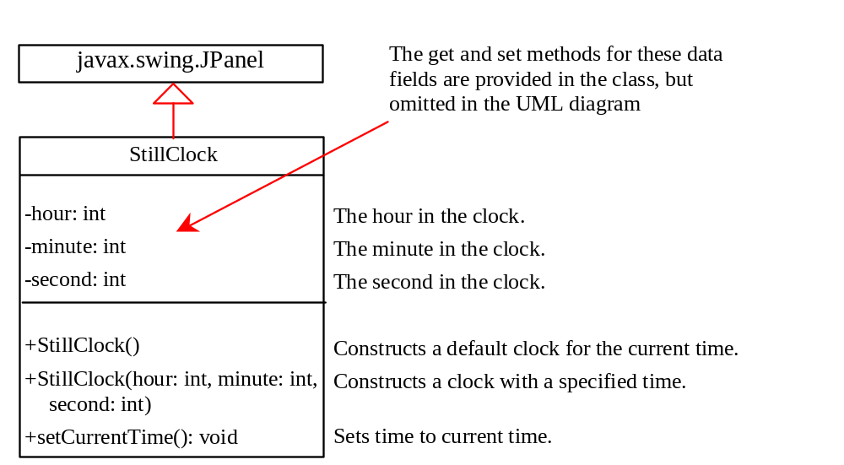
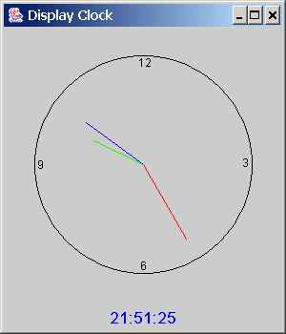
Case Study: StillClock
StillClock
DisplayClock

Slide 21
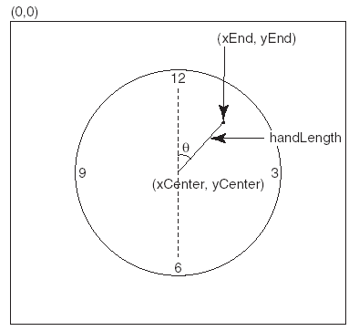
Drawing Clock
xEnd = xCenter + handLength × sin(θ)
yEnd = yCenter - handLength × cos(θ)
Since there are sixty seconds in one minute, the angle for the second hand is
second × (2π/60)

Slide 22
Drawing Clock, cont.
xEnd = xCenter + handLength × sin(θ)
yEnd = yCenter - handLength × cos(θ)
The position of the minute hand is determined by the minute and second. The exact minute value combined with seconds is minute + second/60. For example, if the time is 3 minutes and 30 seconds. The total minutes are 3.5. Since there are sixty minutes in one hour, the angle for the minute hand is
(minute + second/60) × (2π/60)

Slide 23
Drawing Clock, cont.
xEnd = xCenter + handLength × sin(θ)
yEnd = yCenter - handLength × cos(θ)
Since one circle is divided into twelve hours, the angle for the hour hand is
(hour + minute/60 + second/(60 × 60))) × (2π/12)

